Slide 1
Dots n’ spots
Brittany McDonald
2nd Grade

Slide 2
“The Dot” by Peter h. Reynolds
The Dot: YouTube
Author of “The Dot”
Artist and author of various children’s books
Was awarded the title Litterarum Humanarum Doctor in 2007 for his “substantial contribution to education and the arts”

Slide 3
International Dot day
September 15
International Dot Day, a global celebration of creativity, courage and collaboration, began when teacher Terry Shay introduced his classroom to Peter H. Reynolds’ book The Dot on September 15, 2009.
The Dot is the story of a caring teacher who dares a doubting student to trust in her own abilities by being brave enough to “make her mark”. What begins with a small dot on a piece of paper becomes a breakthrough in confidence and courage, igniting a journey of self-discovery and sharing, which has gone on to inspire countless children and adults around the globe.
Notes:
http://www.thedotclub.org/dotday/get-started

Slide 4
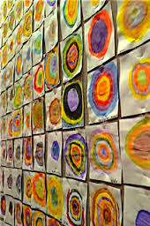
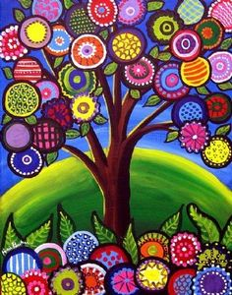
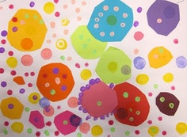
Dot Day
Different student’s artwork from around the world

Slide 5
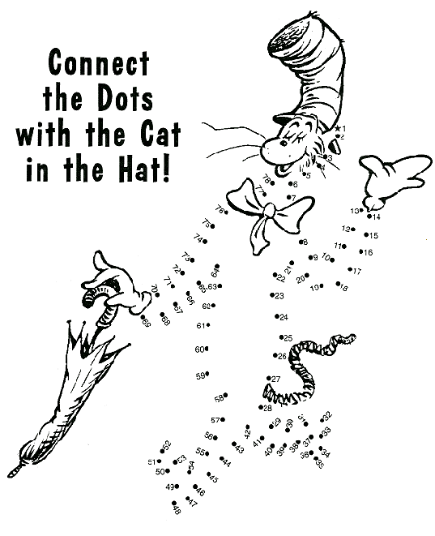
Dots all Around Us

Slide 6
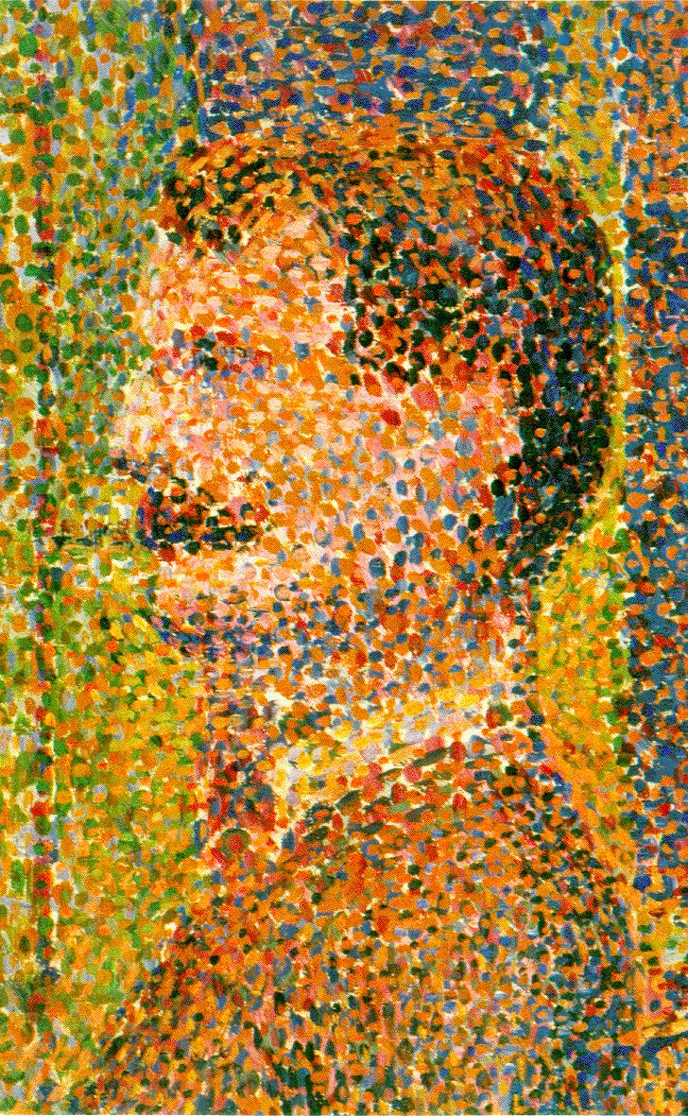
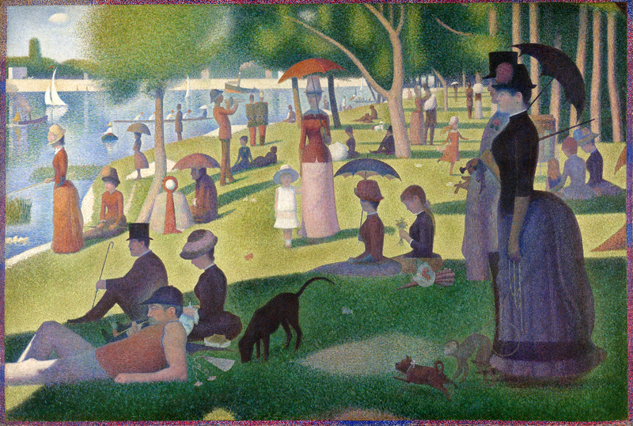
Vocabulary
Pointillism - a style of painting in which a picture is formed from small dots of color
Dot - a small round mark
Shape – how a form is laid out in space
Rhythm- a pattern created using lines, forms, and colors in painting
Notes:
http://en.wikipedia.org/wiki/File:A_Sunday_on_La_Grande_Jatte,_Georges_Seurat,_1884.png

Slide 7
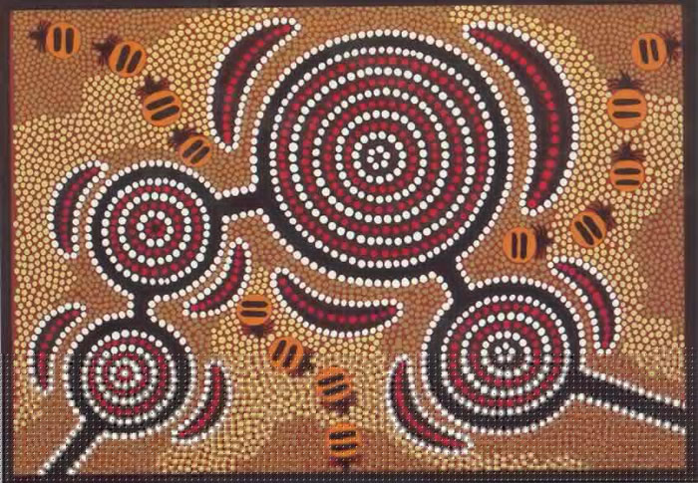
Additional Vocabulary
Indigenous Australian Art - art made by the indigenous (native) people of Australia
Contrast – to be different in a way that is obvious
Analysis - the study of a work through an examination of its component parts and their interrelationships
Story Elements - character, plot, theme, setting, conflict
Visual Representation - 1. visual aid. 2. text aid. 3. pictures, maps, illustrations, etc., which enhance, clarify, or convey meaning

Slide 8
Materials
3 Q-Tips
6 Different Tempura Paint Colors
Paper Towels
Black Construction Paper Square
Newsprint

Slide 9
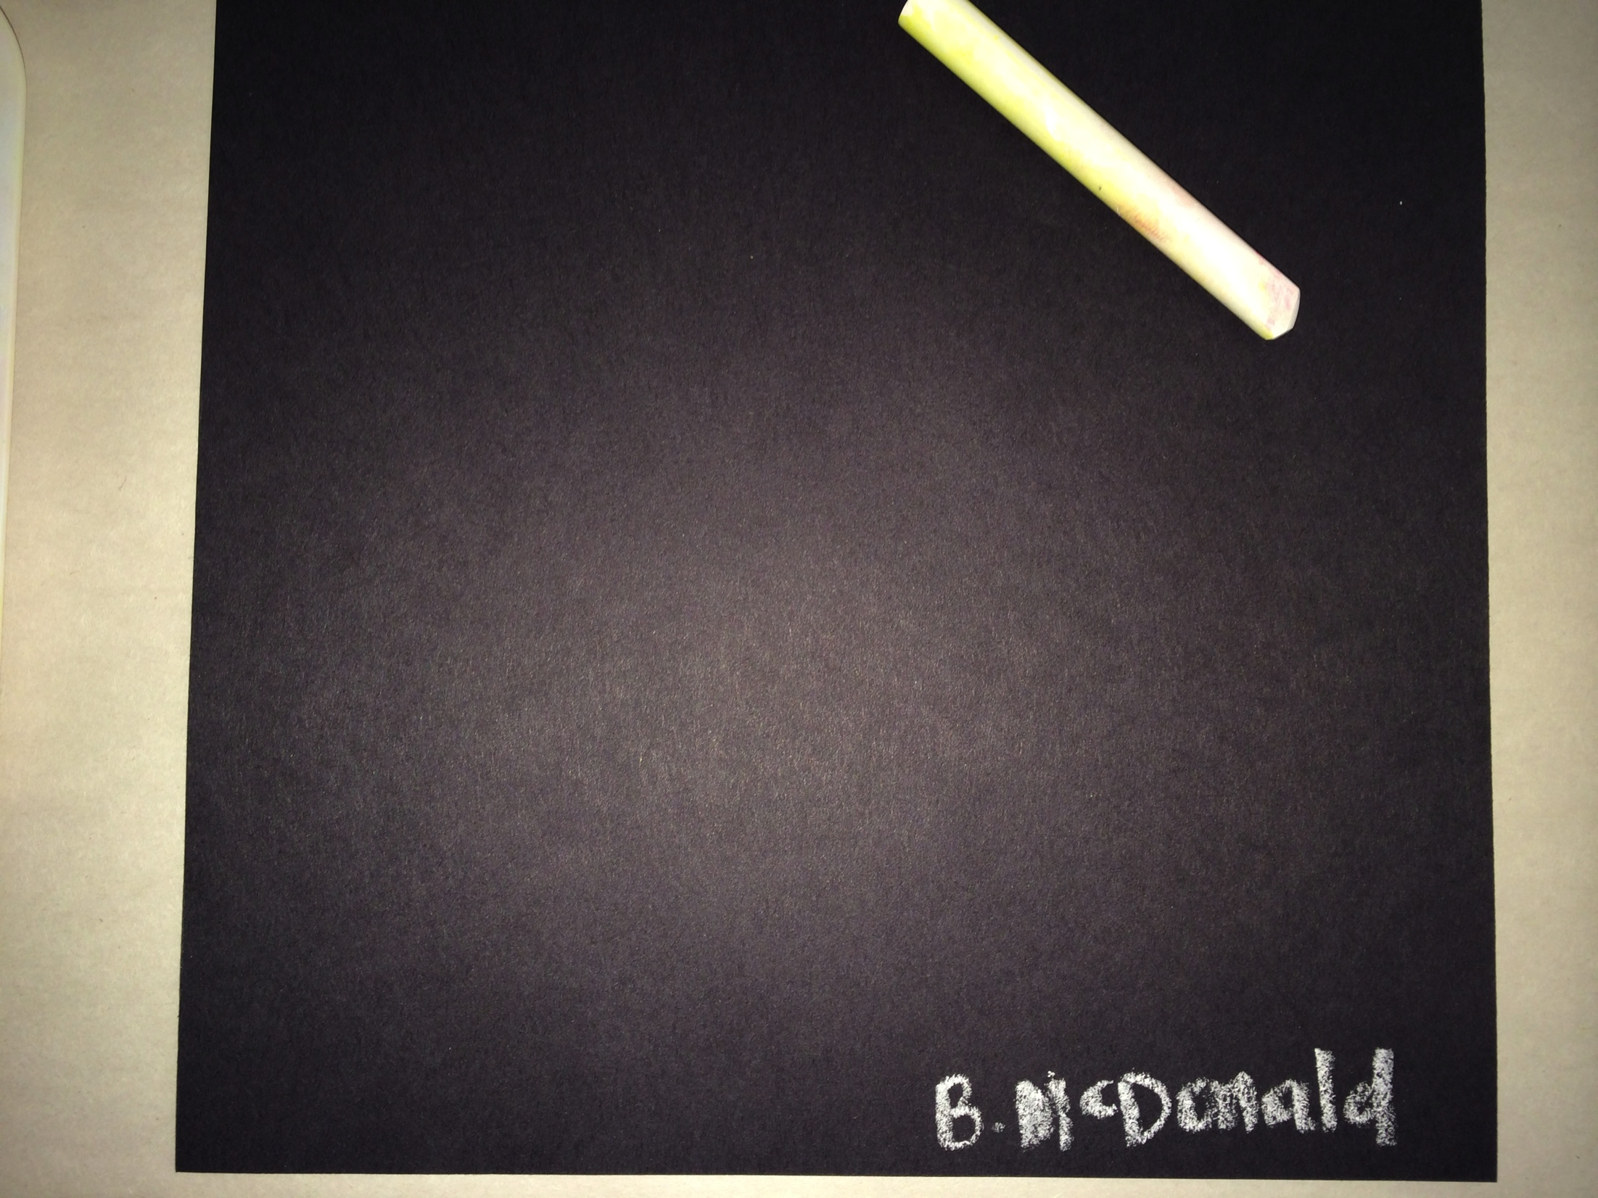
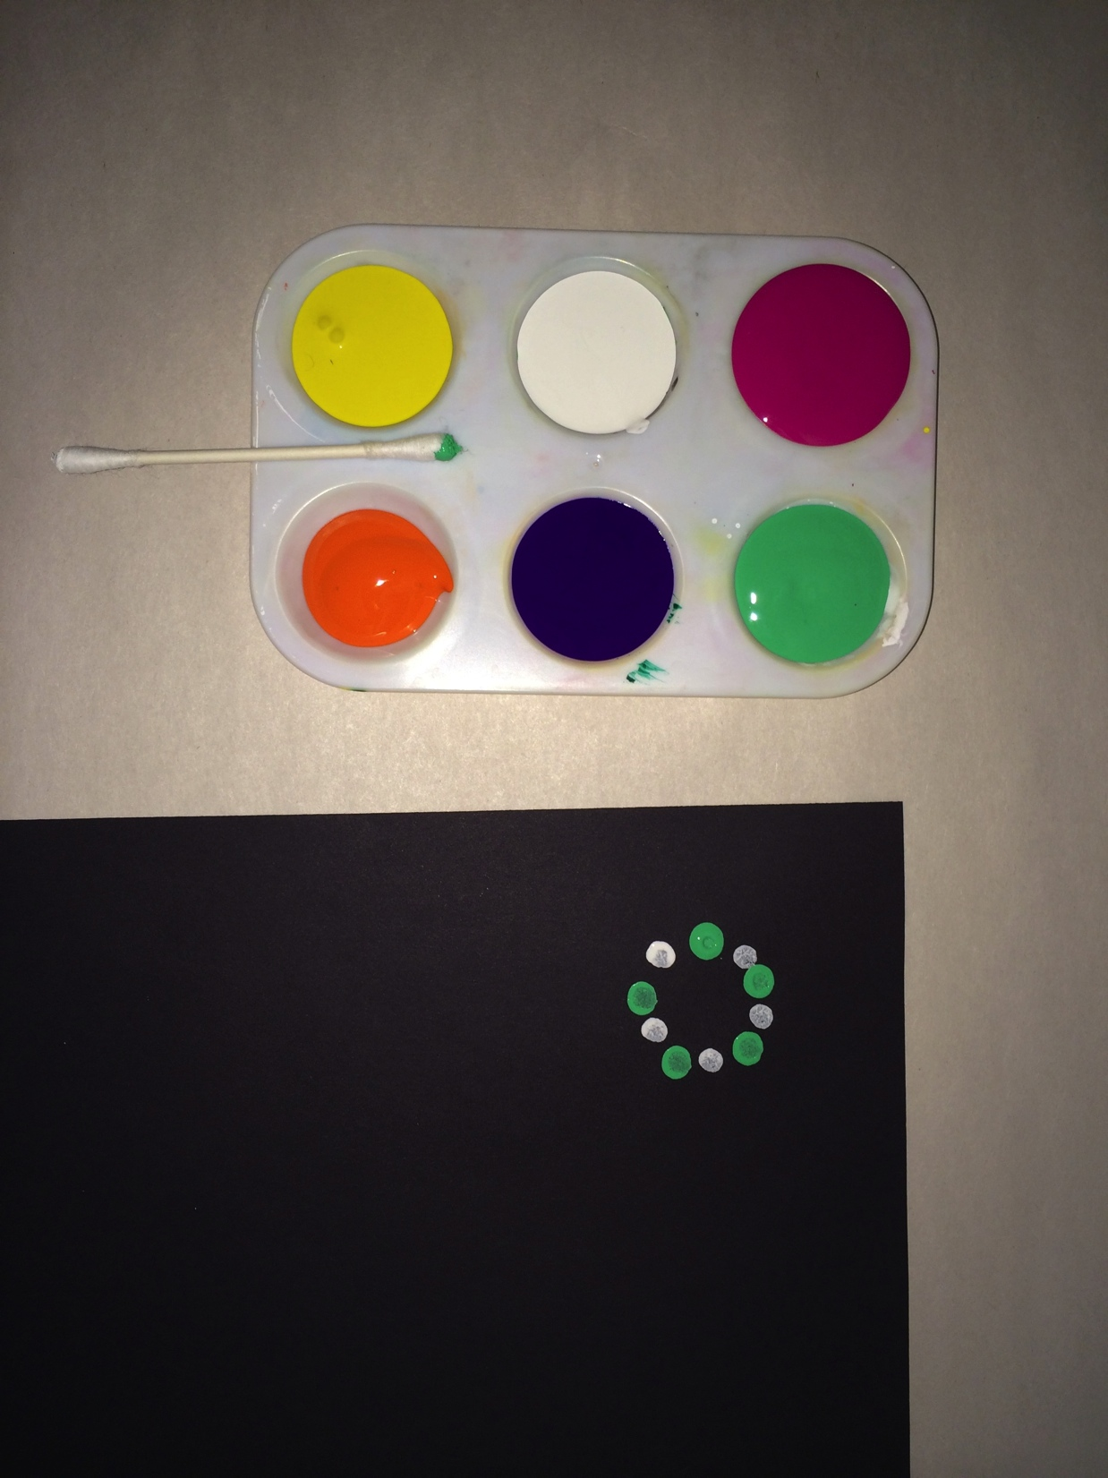
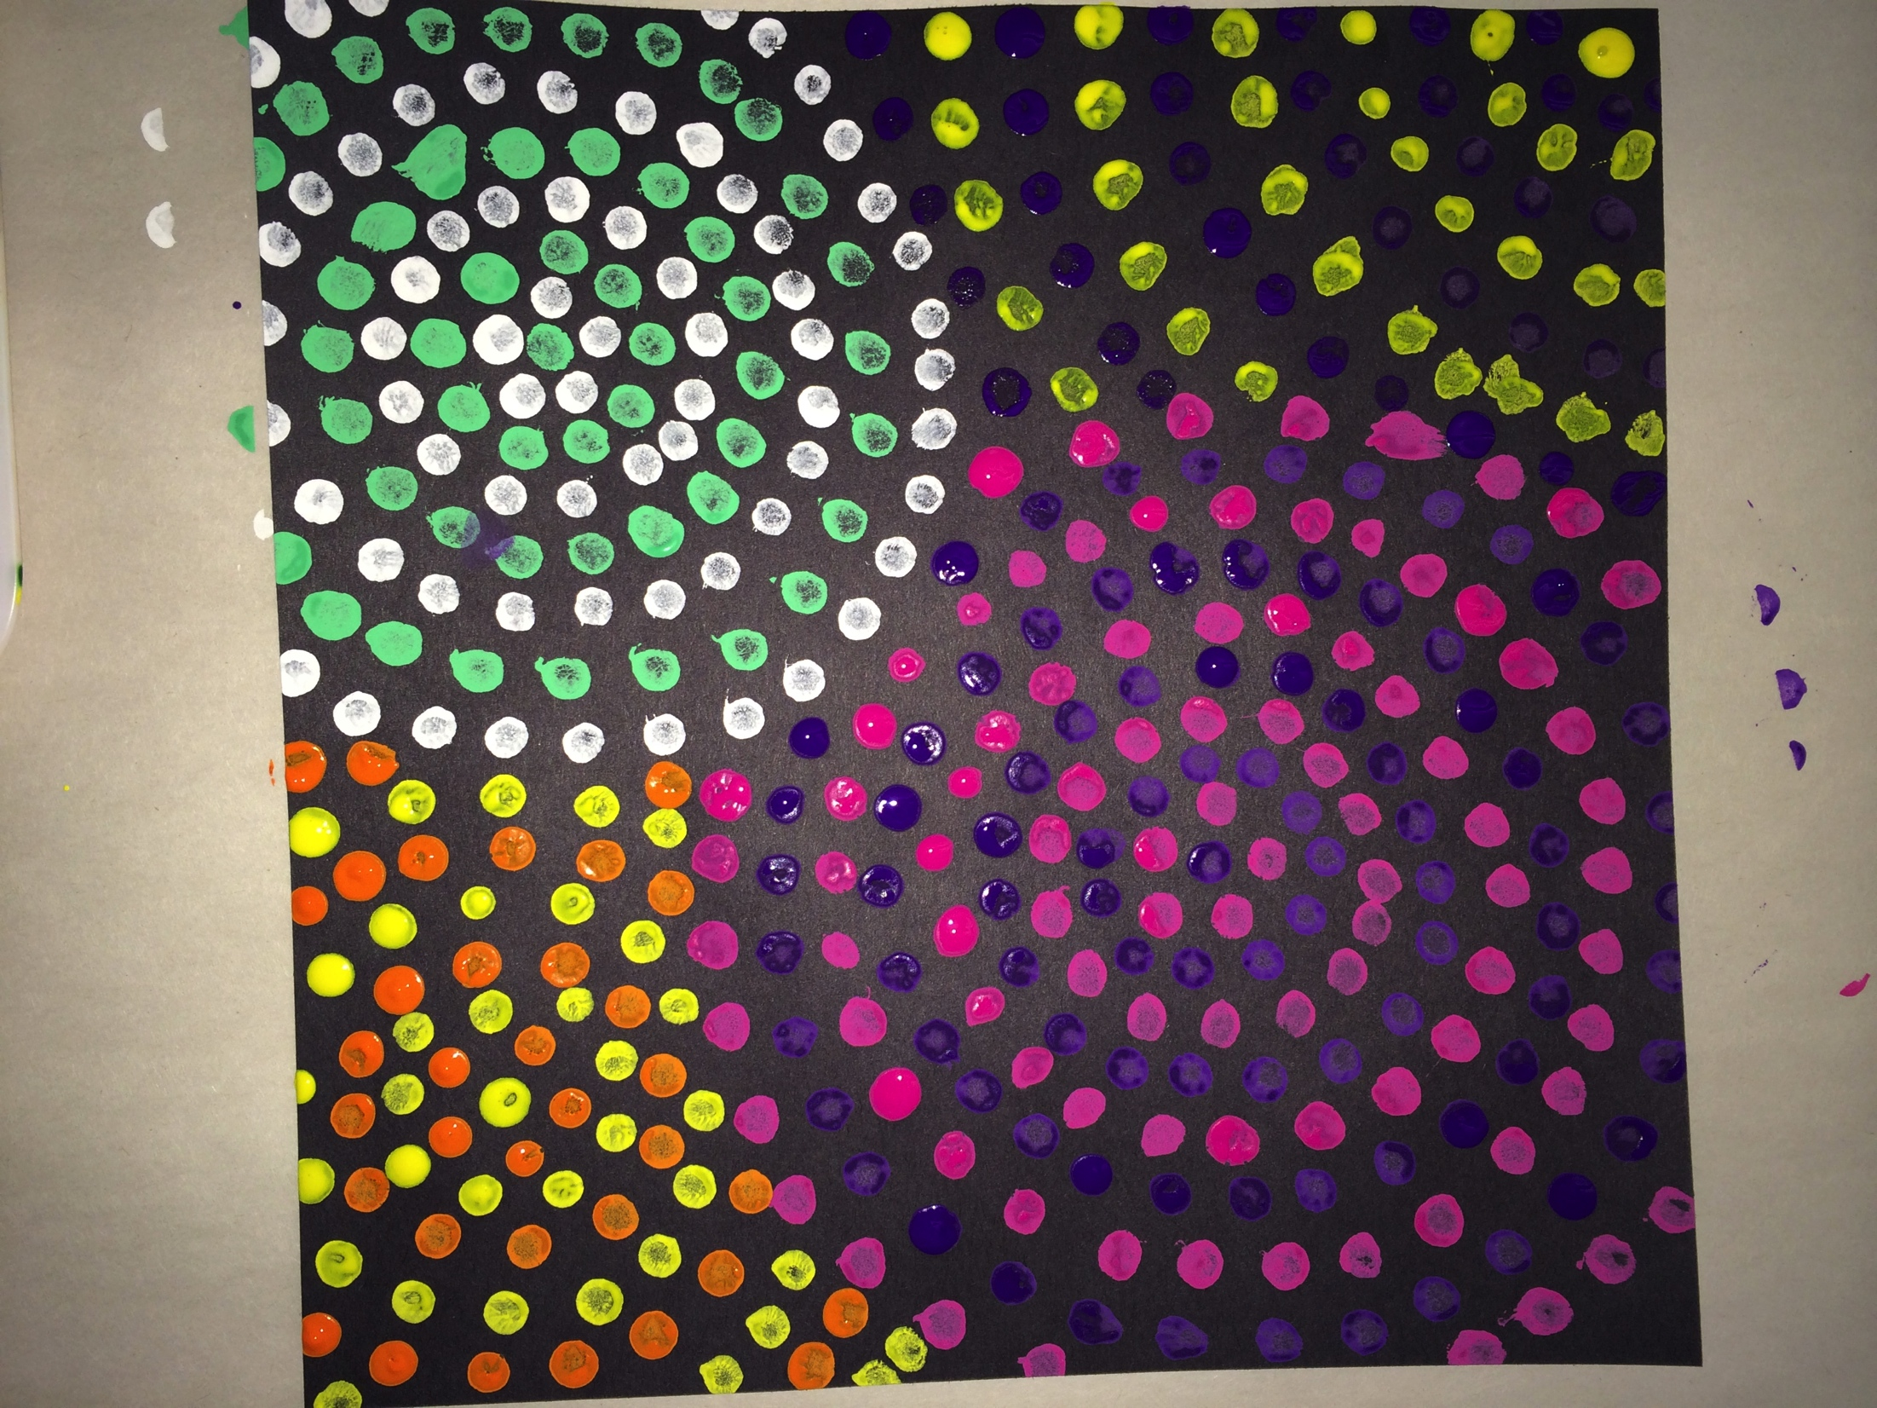
Directions
Pick 2-6 of your favorite colors
Write your name in chalk on the back of your construction paper
Use your Q-Tip to make dots in a contrasting color pattern on your paper
Make as many circles as you would like using at least two contrasting colors

